Slide 1
Finance, Operations & Legal
Overview for Leadership
2019 Leadership Institute

Slide 2
Presentation Outline
Unit & Division Dues: Collection & Distribution
Budgeting & Reserves
Maintaining 501(c)(3) Status – U.S. Only
Form 990 - Annual Tax Returns – U.S. Only
Other Operations Planning – U.S. Only
Contacts and Resources

Slide 3
Unit & Division Dues:
Collection & Distribution

Slide 4
Unit & Division Dues:
Collection & Distribution
Units and Divisions are Required to Submit Signed Annual Assurance Form to be Eligible to Receive Dues:
    Contact Info for Current Officers & Directors
    Copy of Current Bylaws
    U.S. Units & Divisions – Most Recent 990 Tax Return
    Miscellaneous Questions to Ensure Compliance

Slide 5
Unit & Division Dues:
Collection & Distribution
UNITS
Annual Report Provided of Dues Paid by Member & Member Level
Payments Sent by Check Once Per Year (March)
DIVISIONS
Monthly Financial Statements Provided to All Divisions
Division Dues Paid Monthly or Quarterly (Division’s Preference)
Payment by ACH Available (Contact CEC HQ)

Slide 6
Budgeting & Reserves
Budgeting
Budgeting IS a roadmap to financial goals
Budgeting IS NOT a crystal ball
Monitoring actuals vs. budget - where are we compared to where we want to go?
Pay particular attention to bottom line – make adjustments to reach goal
Drill down to individual line items to determine areas of necessary adjustment or success.

Slide 7
Budgeting & Reserves
EXAMPLE

Slide 8
Budgeting & Reserves
Reserves
How many months can operations be maintained with no additional cash coming in?
Liquid Assets (Cash / Investments)
Less: Short-Term Liabilities (bills due within 30 days)
Divided by Average Monthly Expenses
3 months is average reserve – 6 months is better
If reserves are 1 year or more (guideline), may be stockpiling money; need to expand programming / make donations

Slide 9
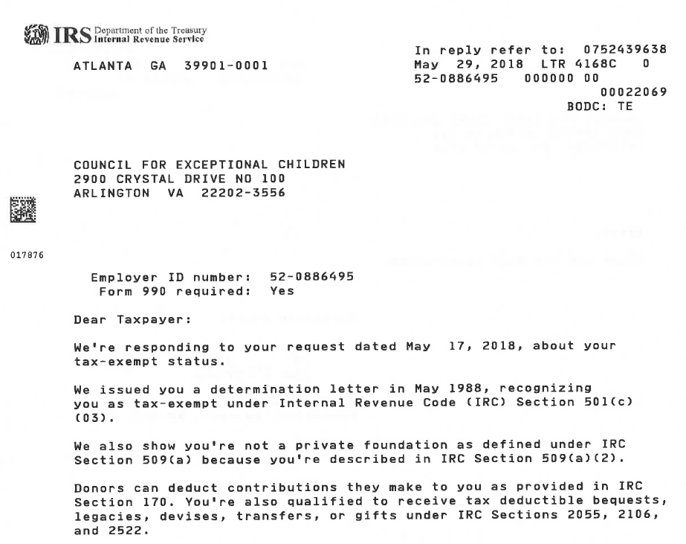
Maintaining 501(c)(3) Status
(U.S. Only)
Contact IRS (877) 829-5500 to request an
“affirmation letter” or “determination letter”

Slide 10
Maintaining 501(c)(3) Status
(U.S. Only)
Cannot endorse or fund political candidate or organization
May lobby in limited amount if it furthers 501(c)(3) mission
Cannot generate excessive UBI (Unrelated Business Income)
File Annual 990 Tax Return
Make 990 available to public upon request

Slide 11
Maintaining 501(c)(3) Status
(U.S. Only)
Keeping Orderly Records Allows for Transfer of Information to Future Unit & Division Leaders
Documents to Keep On File
Articles of Incorporation
Bylaws
990 Tax Returns (5 - 7 Years)
IRS Determination Letter

Slide 12
Form 990 – Annual Tax Returns
(U.S. Only)
Revenues > $200K OR Assets > $500K – File Full Form 990
Accountant Assistance Recommended
Revenues < $200K AND Assets < $500K – File Form 990EZ
Probably DIY
Revenues < $50K – File Form 990N
Definitely DIY – Basic Info on Postcard-Sized Form

Slide 13
Other Operations Planning
(U.S. Only)
Insurance
Forrest T. Jones & Company – Provides Insurance Options for CEC, Units & Divisions
Do not have to use FTJ – Can use any provider
Insurance Types to Consider
Directors & Officers
Commercial & Liability
Convention & Events
Errors & Omissions
Other

Slide 14
Other Operations Planning
(U.S. Only)
Annual Audit
Independent Agency Hired to Review Financial Reporting and Internal Controls
Is considered optional in most states for Non-Profits
Recommended even if not required; best business practice, especially for larger organizations or fundraising organizations

Slide 15
Other Operations Planning
(U.S. Only)
Miscellaneous
Each Unit and Division is a separate legal entity from CEC National; must have own Tax ID Number
Internal Witten Policies
  Whistleblower?
  Conflict of Interest?
  Confidentiality?

Slide 16
Contacts & Resources
CEC HQ Contacts
Craig Evans – CFO
craige@cec.sped.org (703) 264-9416
Division Monthly Statements / Division Dues Transfers
Tiffany Lewis – Sr. Accountant
tiffanyl@cec.sped.org (703) 264-9410
Assurance Forms / Unit Dues Transfers
Bryan Reynolds – Membership & Database Manager
bryanr@cec.sped.org (703) 264-9480

Slide 17
Contacts & Resources
(U.S. Only)
stayexempt.irs.org
Everything you need to know about obtaining and maintaining 501(c)(3) tax-exempt status
FAQs, Video Courses, Resources
irs.gov/charities-non-profits
Information on 990s and filings
Information on reinstatement of 501(c)(3) status
Educational resources and guidance

Slide 18

Contacts & Resources
www.cec.sped.org About Us CEC Leadership Unit and Division Leadership Resources
“Leadership Finance & Operations Guide 2019”
Dues Collection
990 Information
501(c)(3) Maintenance
Resource Contacts
More

